Slide 1

Dwelling into the world of
Quantum Computing
By Sathvik Kamegaonkar

Slide 2
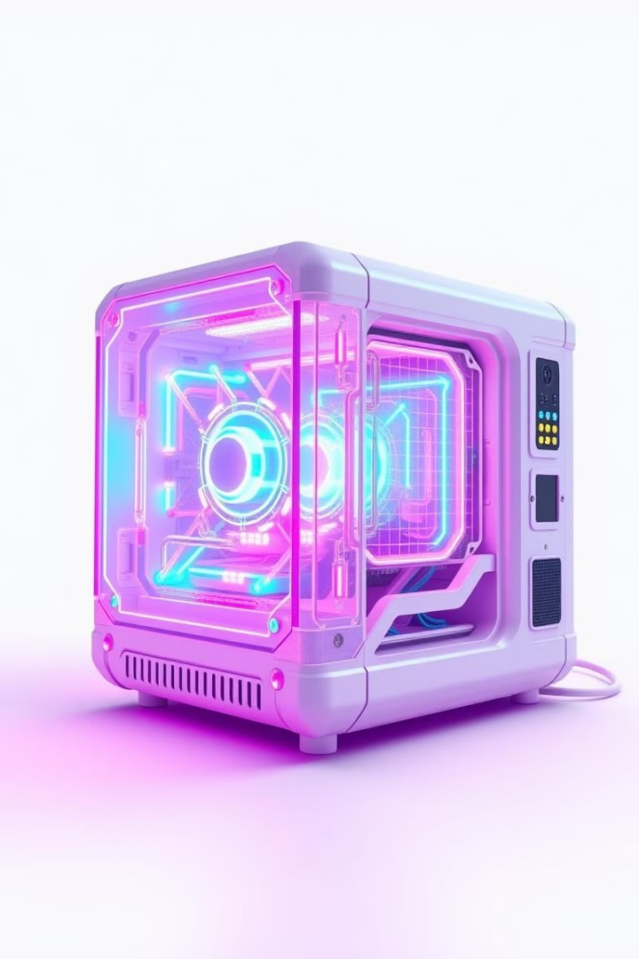
Introduction to Quantum Computing
This presentation will delve into the captivating realm of quantum computing, exploring its fundamental principles, diverse applications, and the transformative potential it holds for the future. We will embark on a journey through the quantum world, uncovering the unique properties of quantum mechanics and how they empower this revolutionary technology. Prepare to be amazed as we unravel the mysteries of superposition, entanglement, and the power of quantum algorithms, paving the way for a future where computing reaches new frontiers.

Slide 3
What is Quantum Computing?
Quantum computing is a type of computing that harnesses the principles of quantum mechanics to solve problems that are too complex for traditional computers. This allows quantum computers to tackle challenges in fields like medicine, materials science, and artificial intelligence.
Traditional Computing
Quantum Computing
Based on classical bits, which can be either 0 or 1.
Utilizes qubits, which can be 0, 1, or both simultaneously, due to the principle of superposition.
Operates on deterministic logic.
Processes information sequentially.
Leverages quantum phenomena like superposition and entanglement.
Limited in its ability to handle large datasets and complex calculations.
Performs computations in parallel, offering significant speed advantages for certain problems.
Has the potential to revolutionize various industries by enabling the solution of currently unsolvable problems.

Slide 4

Basics of Quantum Mechanics
Quantum mechanics delves into the microscopic world, where classical physics breaks down. It unveils phenomena like superposition and entanglement, shaping the foundation of quantum computing.
1
Superposition
2
Entanglement
3
Measurement
Qubits can be in multiple states at once, unlike classical bits. This allows for parallel computation and faster problem-solving.
Entangled qubits are interconnected, even when separated. Measuring one instantly affects the other, regardless of distance.
Measuring a qubit in superposition collapses it to a definite state, revealing its potential.

Slide 5

Superposition: Qubits can be in multiple states simultaneously
A qubit can be in a superposition of states, meaning it can be both 0 and 1 at the same time. This is a fundamental difference from traditional bits, which can only be in one state at a time. Superposition is a key principle in quantum computing, enabling the exploration of multiple possibilities concurrently.
Imagine a coin spinning in the air, representing a qubit. Before it lands, it exists in a state of superposition, where it's neither heads nor tails but rather both simultaneously. Only when the coin lands (measurement) does its state collapse to a definite value. This parallel exploration of possibilities allows quantum computers to solve certain problems exponentially faster than classical computers.
Traditional Bit
Qubit
Can only be 0 or 1. It is like a coin that has already landed, revealing a single outcome. Each bit represents a single value, limiting the possibilities for parallel exploration.
Can be 0, 1, or a combination of both. It is like a coin spinning in the air, representing multiple possibilities before it lands. Qubits can exist in a superposition of states, allowing for a broader range of computational possibilities and parallel exploration.

Slide 6



Entanglement: Qubits can be interconnected, affecting each other’s states
Entanglement is a phenomenon where two or more qubits become linked, even when physically separated. This means that measuring the state of one entangled qubit instantly affects the state of the other, regardless of the distance between them.
Imagine two coins spinning in the air, entangled with each other. When one coin lands, revealing heads or tails, the other coin instantly collapses to the opposite state. This is a fascinating consequence of entanglement, where the fate of one qubit is directly tied to the other, regardless of spatial separation.
Qubit 1
Qubit 2
Changes in the state of Qubit 1 instantly affect the state of Qubit 2, regardless of distance.
The state of Qubit 2 is correlated with the state of Qubit 1.

Slide 7
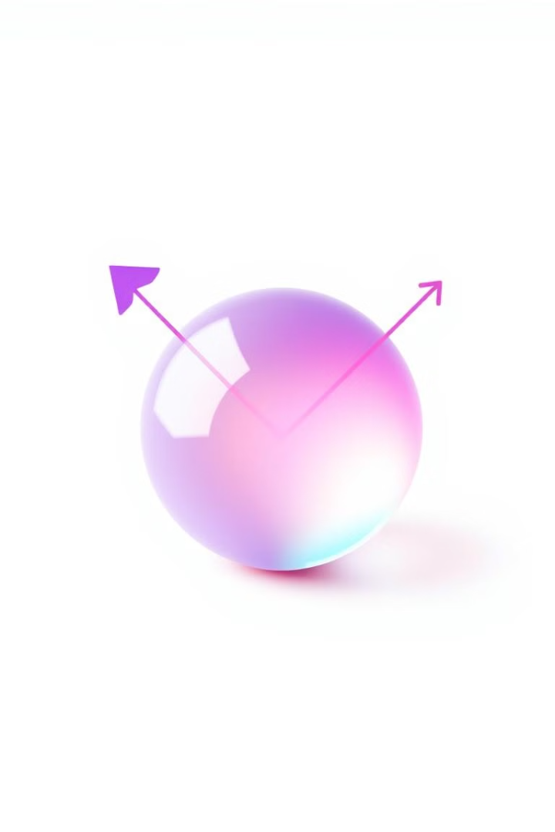
Measurement
When a qubit is measured, its state collapses to a definite value, either 0 or 1. This process of measurement is analogous to observing the outcome of a spinning coin. Before the coin lands, it exists in a state of superposition, representing both heads and tails simultaneously. The moment the coin lands, its state collapses to a definite value, either heads or tails. Similarly, measuring a qubit forces it to adopt a specific state, 0 or 1, effectively collapsing its superposition state.
Before Measurement
Superposition
After Measurement
Definite Value

Slide 8

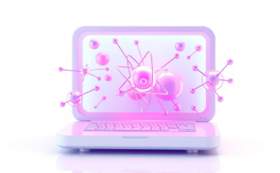
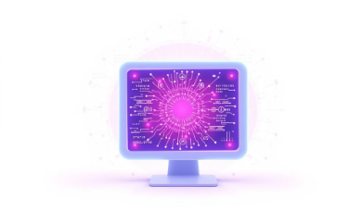

Applications of Quantum Computing
Drug Discovery
Materials Science
Algorithm Development
Cryptography
Quantum computers can accelerate drug discovery by simulating molecular interactions, enabling the design of new drugs with enhanced efficacy and reduced side effects.
Quantum simulations can lead to new materials with superior properties, revolutionizing industries like energy, transportation, and electronics.
Quantum computers pose a threat to traditional encryption but also offer opportunities for more secure cryptographic techniques.
Quantum algorithms offer significant performance improvements in optimization, machine learning, and artificial intelligence.

Slide 9
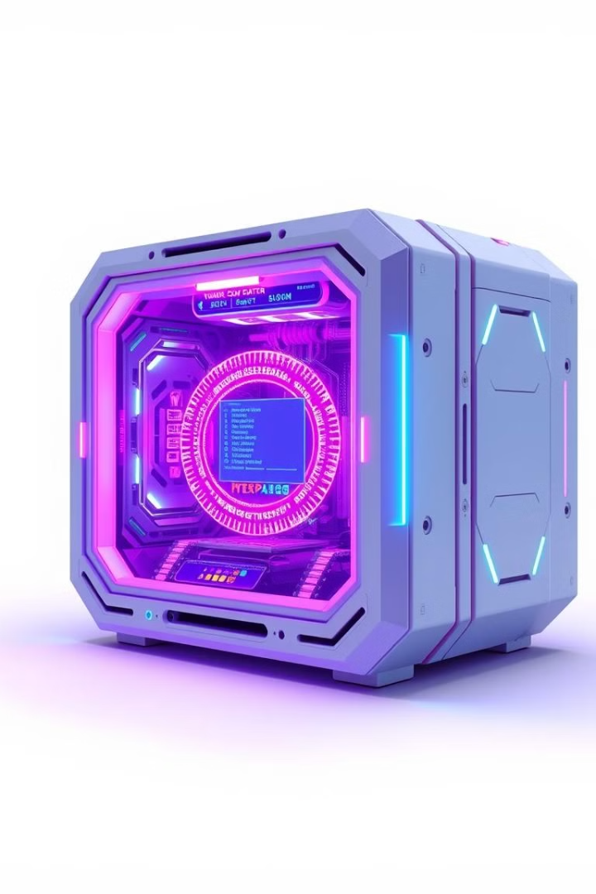
Challenges in Quantum Computing
Despite its potential, quantum computing faces significant challenges. These hurdles are related to qubit instability, scalability, cost, and the development of error correction techniques.
1
Qubit Instability
2
Scalability
Qubits are highly sensitive to environmental noise, which can lead to errors in their quantum states.
Building large-scale quantum computers with a sufficient number of qubits is a major challenge.
3
Cost
Quantum computers are currently very expensive to build and operate.

Slide 10

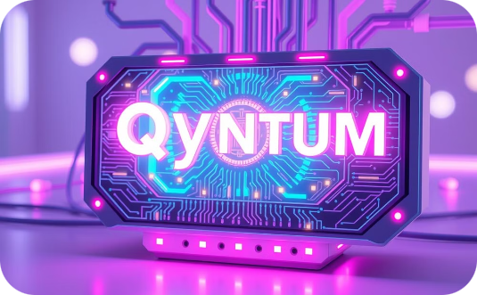
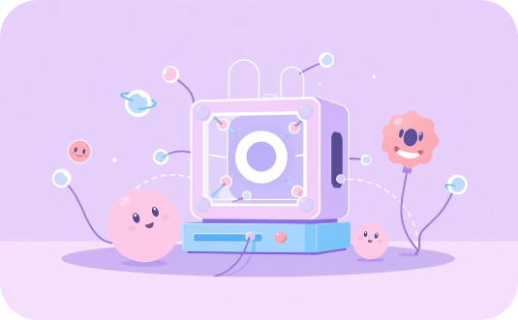
Quantum Supremacy and Milestones
2019
2020
2023
Google achieved quantum supremacy with its Sycamore processor, demonstrating the potential of quantum computing to solve intractable problems.
IBM announced the development of a 64-qubit processor, marking a significant step towards building larger and more powerful quantum computers.
Researchers continue to focus on improving qubit stability, scalability, and error correction, paving the way for more reliable and practical quantum applications.

Slide 11

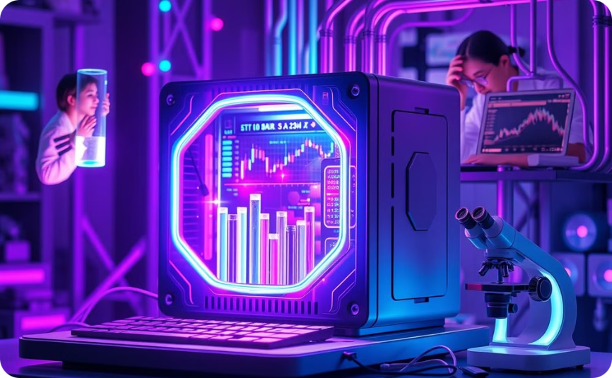
The Future of Quantum Computing
Quantum computing is poised to transform various industries in the years to come. It is expected to revolutionize fields such as medicine, materials science, and artificial intelligence, unlocking new possibilities and solutions that were previously inconceivable.
Increased Power and Scalability
Broader Applications
Quantum computers will become more powerful and scalable, enabling complex simulations and computations. This will enable scientists and researchers to address complex problems in areas like drug discovery, materials design, and financial modeling. As quantum computers evolve, they will be capable of handling increasingly intricate calculations, pushing the boundaries of scientific discovery and technological advancement.
Quantum computing will find applications in a wider range of industries, driving innovation and progress. Beyond its current applications in cryptography and optimization, quantum computing will be used to develop new materials, design more efficient energy systems, and accelerate drug discovery. This will lead to breakthroughs in various fields, ultimately improving our quality of life and shaping the future of our world.

Slide 12
Thank You

